Slide 1

BUSINESS DATA MANAGEMENT
CAPSTONE PROJECT
DIRECT-TO-CONSUMER MILKMAN BUSINESS EXPANSION: MAXIMIZING REVENUE AND EFFICIENCY
Presented by: Himanshu Tiwari
Roll No: 21f1004266
Email: 21f1004266@ds.study.iitm.ac.in

Slide 2

OVERVIEW
01
02
03
Executive Summary
Data Collection
Data Analysis
04
05
Findings
Recommendations

Slide 3



EXECUTIVE SUMMARY
The project revolves around a small milk delivery business in Sultanpur, Uttar Pradesh, operated by Mr. Rajesh Dubey, who started the business three years ago.
His sales comprise various milk types (Type 1, Type 2, Type 3), where "Type 1", "Type 2" and "Type 3" cater to different quality preferences for customers, where "Type 3" denotes the highest quality milk. Additionally, sales include condensed milk and discounted offerings to local dairies.
The business faces profitability challenges as the milkman sells milk to dairy at lower prices instead of directly to customers, limiting profit margins and hindering growth. Additionally, there are constraints in expanding operations and reaching new markets.

Slide 4

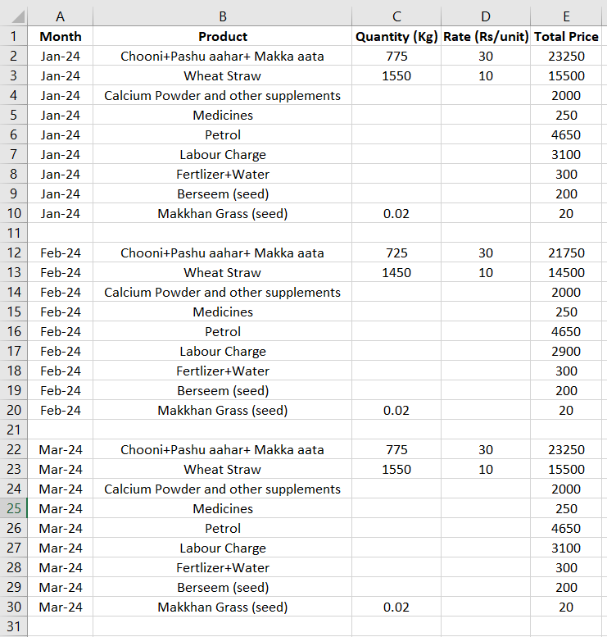
Data Collection
The data for the sales and expenditure for three months was meticulously recorded.
The data was gathered directly from Mr. Rajesh over a three-month period through regular interactions or at specified intervals.
To organize and clean the data, we used Excel, making it easier to analyze and facilitating future data analysis.

Slide 5

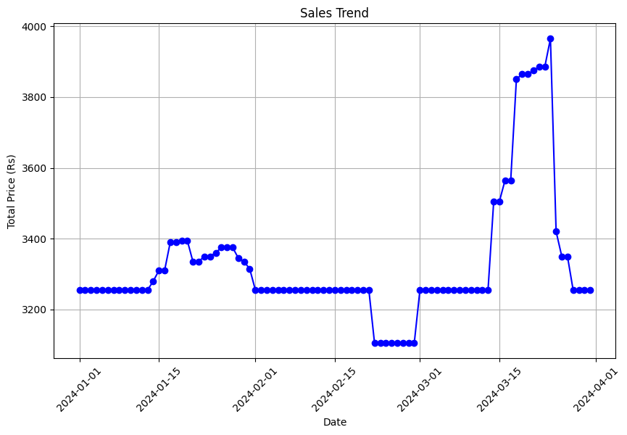
Data Analysis
Sales Analysis
January: Stable sales until mid-month, with notable peaks on January 17th, 18th, and 26th due to the wedding season.
February: Consistent sales until February 21st, followed by a decline attributed to reduced demand from hospitals.
March: Fluctuating sales with steady revenue until mid-month, followed by a significant surge from March 14th to March 24th due to the festival season, particularly Holi.

Slide 6
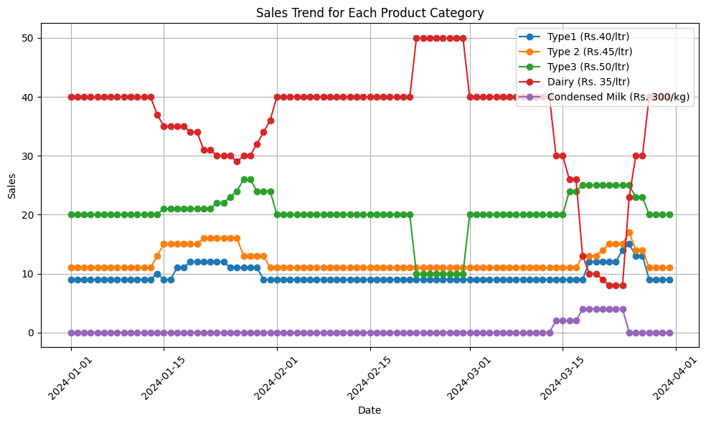
Data Analysis
Sales Analysis
Sales to dairy at Rs. 35 per litre consistently dominate revenue, despite fluctuations in other categories.
Type 2 milk sales exhibit a notable upward trend, indicating sustained demand and revenue growth.
Type 1 and Type 3 milk sales remain stable, reflecting consistent customer demand.
The analysis indicates that condensed milk experiences a surge in demand during festive seasons, suggesting a seasonal pattern in consumer preferences.

Slide 7
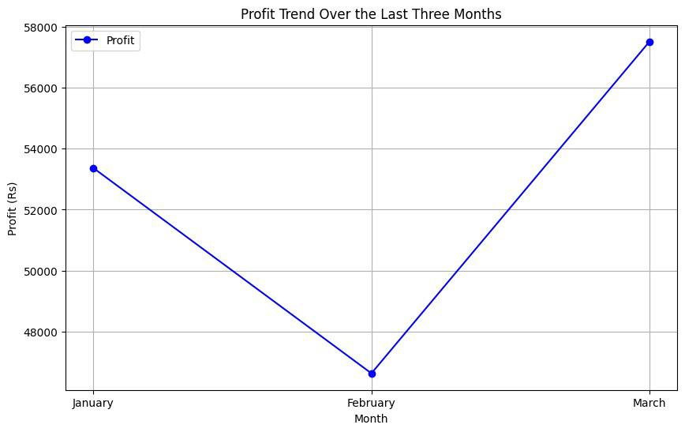
Data Analysis
Profit Analysis
January: The profit for January was Rs. 53,365, indicating a healthy level of profitability.
February: Profit decreased slightly to Rs. 46,625 compared to January, likely due to reduced sales from hospitals towards the end of the month.
March: Profit increased to Rs. 57,515, surpassing both January and February, indicating an improvement in business performance.

Slide 8
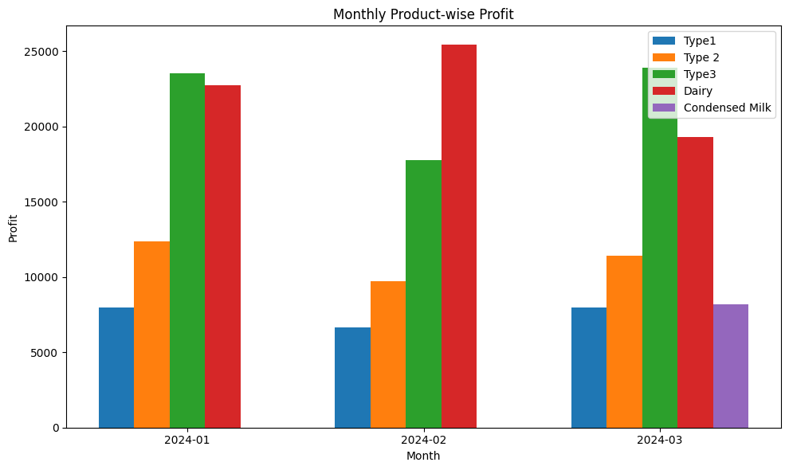
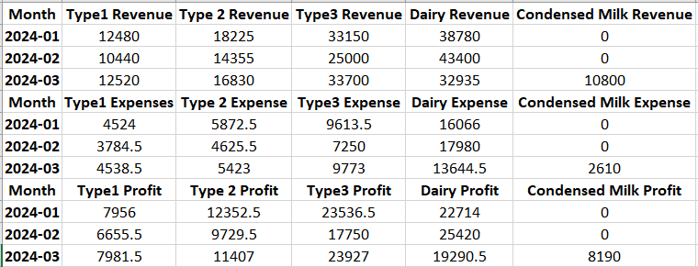
Data Analysis
Profit Analysis
The profit analysis was conducted utilizing a methodology tailored to the specific context of the business, where no direct purchase costs were incurred. Instead, monthly expenses were allocated to determine the production cost of milk.
With product-wise revenue and expenses identified, the profitability analysis proceeded by calculating the product-wise profit for each month.

Slide 9
Findings
Rs 50 milk (Type 3) sales remained relatively stable throughout the period, with minor fluctuations observed.
Rs 45 milk (Type 2) sales exhibited a notable upward trend, indicating sustained and growing demand for this product.
Rs 35 milk (which is sold to Dairy) is consistently profitable due to its stable sales volume, which covers production costs and generates profit.
Conversely, Rs 40 milk (Type1) is experiencing less profit, primarily attributed to lower sales quantities. The lower demand for Rs 40 milk affects its ability to cover production costs, resulting in less profits despite its higher price point compared to Rs 35 milk.
As for condensed milk, its profitability fluctuates due to its seasonal nature. Since condensed milk is likely to have peak demand during specific times of the year, its production and pricing strategies should align with seasonal demand patterns.

Slide 10

Recommendations
Optimize Sales to Dairy
Explore alternative approaches other than dairy : partnering with local cafes, restaurants, and supermarkets
It is recommended to adjust pricing based on cost analysis. Increasing the price by a small amount may not significantly bother the customer, but it can certainly increase profitability.
Profit-Driven Pricing
Quality Control Enhancement
Regularly inspect product quality, train staff in milk production, processing, and handling, and set up a customer feedback system.
Given the absence of door-to-door delivery options for the women farmers, Mr. Rajesh can expand his product range & boost revenue by leveraging his existing distribution network.
Support Local Women Farmers
Seasonal Demand Optimization Strategy
Pricing strategies should match seasonal demand patterns. Adjusting prices during peak seasons to capitalize on increased demand can maximize profitability.

